Slide 1

QA Consulting – IMS Project
Gabriel Zubairu
Trainee Consultant

Slide 2
Contents
Introduction
My Consultant Journey
Continuous Integration
Demonstration Of Application
Overview Of Project
References
Questions

Slide 3
Introduction

Slide 4

OBJECTIVE
To create an application with utilisation of supporting tools, methodologies and technologies that encapsulate all fundamental modules covered during training.
Agile & Project Management
Databases
Cloud Fundamentals
Programming Fundamentals
Continuous Integration
Automated Testing

Slide 5
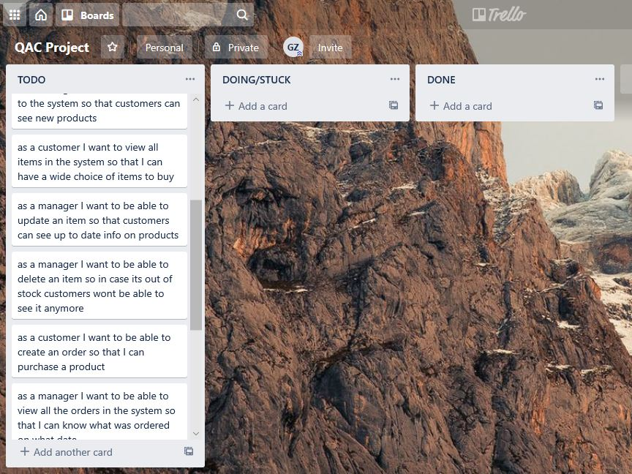
Initial Plans
I created a Kanban board(Trello) full of user stories I created.
I created an ERD of the tables I would include in my database.
A Risk assessment was made of the risks which I though were both likely and unlikely during the project.

Slide 6
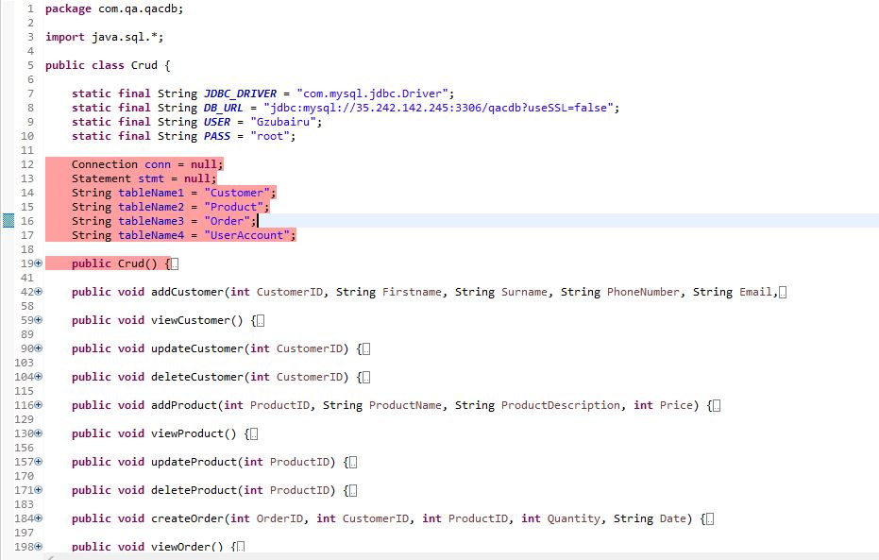
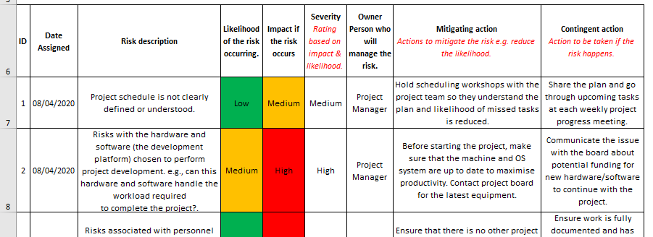
Initial Plans

Slide 7
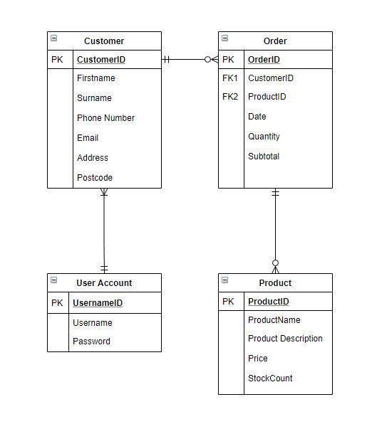
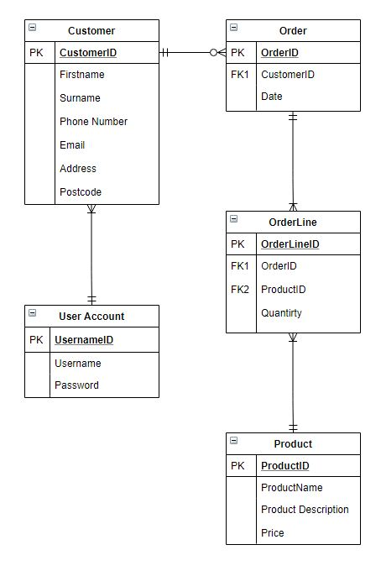
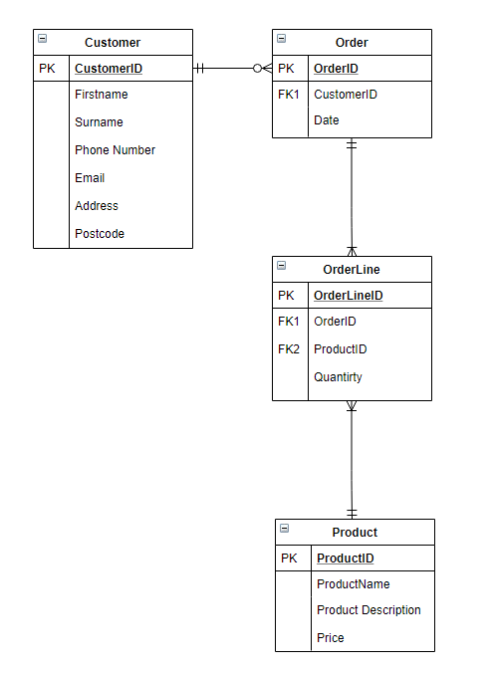
Evolution of ERD

Slide 8
My Consultant Journey

Slide 9

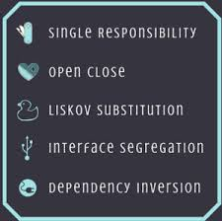
What I have learnt
Agile
Object Oriented Principles
S.O.L.I.D
Cyber Security
Networking

Slide 10





Software I learnt to use

Slide 11
Continuous Integration

Slide 12
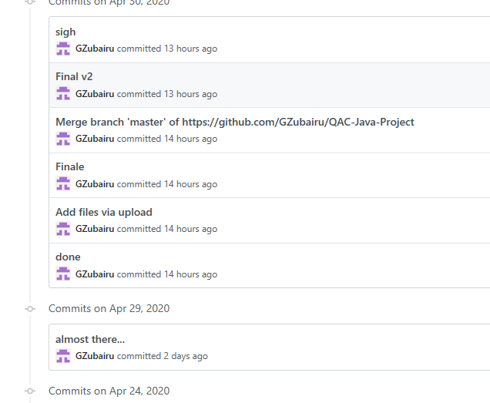
Github
The Version Control System I used was Github.
As I built my application, I continuously integrated it by committing and pushing code to the repository.

Slide 13
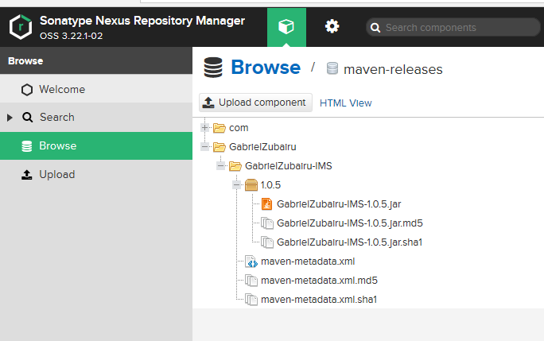
Nexus Repository Manager
I built a fat jar with the dependencies I used on the project
People anywhere in the world can run this application

Slide 14
Demonstration Of Application

Slide 15
Overview Of Project

Slide 16
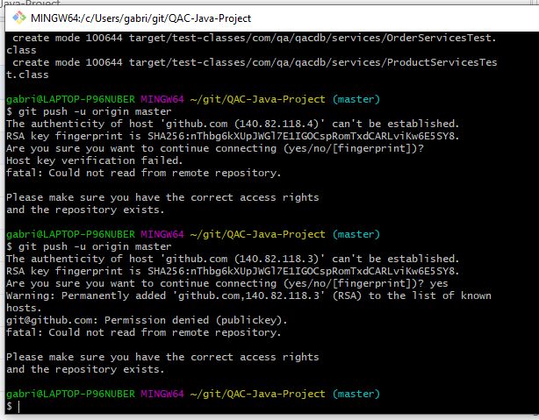
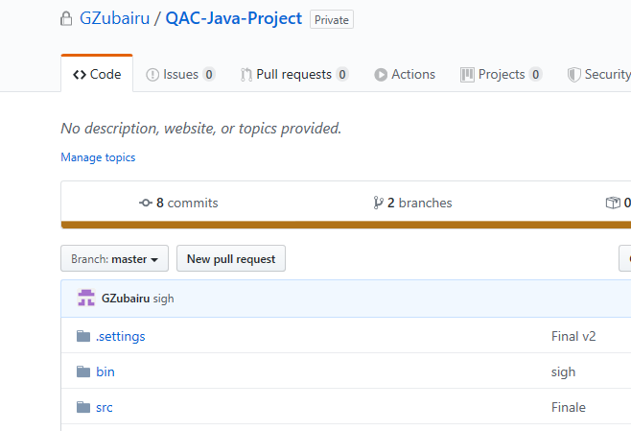
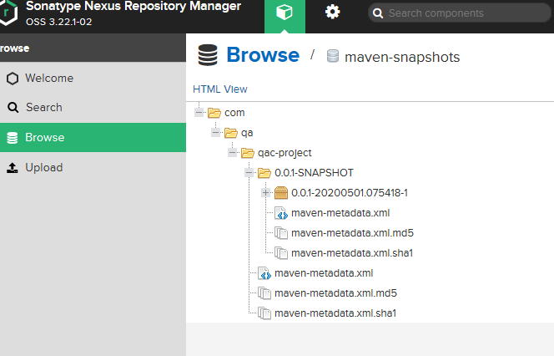
Errors I occurred

Slide 17
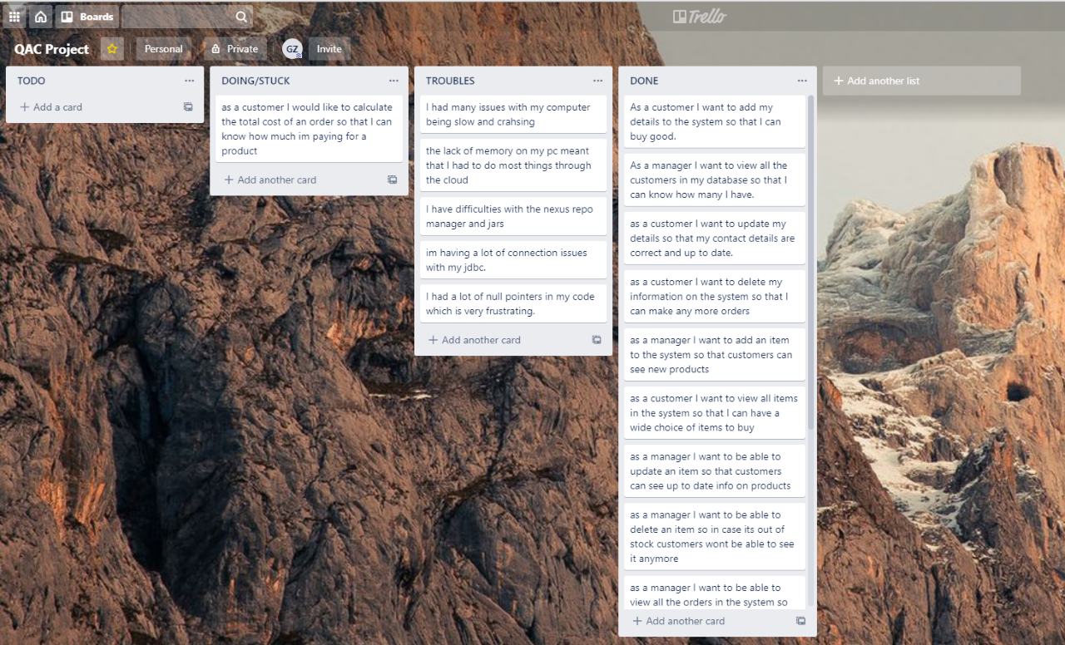
Self Assessment
After Screenshot of my Kanban board
I added a column which included troubles I faced during the project
I was able to complete all but one of my user stories

Slide 18
What went well
Use of OOP and S.O.L.I.D principles within eclipse
Kanban board with user stories
Good understanding of concepts taught in each module and applied it when necessary.

Slide 19
What can I improve on
Functionality of the program; allow users to see total cost
Being “Agile”; making the most of scrum meetings
Github
Time keeping
Keeping stress levels low when things go wrong

Slide 20
References
https://github.com/GZubairu/FinalProject

Slide 21
Questions

